Slide 1
Networking Fundamentals
Foundations of Ethernet and IP

Slide 2
Network Topologies
#
Enterprise LAN and WAN design

Slide 3
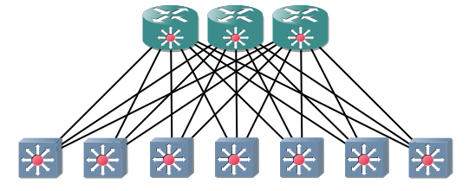
Spine-Leaf Topology
2 layers
All leaves connect to all spines
Spines are not connected
More commonly used in data centers
Spine
Leaves

Slide 4
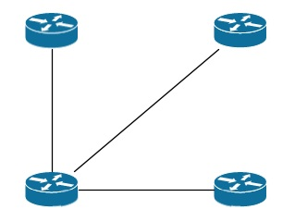
WAN Topologies – Hub & Spoke
Benefits
Fewer links
Cost savings
Simplified management
Drawbacks
Bottleneck at the hub
Possible single point of failure at hub

Slide 5
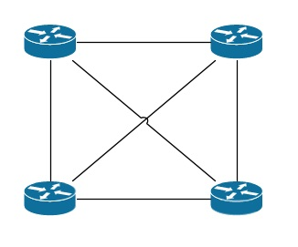
WAN Topologies – Full Mesh
Benefits
Maximum redundancy
Drawbacks
Possibly infeasible management
Most number of links
Highest cost

Slide 6
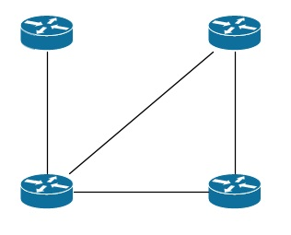
WAN Topologies – Partial Mesh
Benefits
Fewer links than full mesh
More redundancy than hub and spoke
Cost less than full mesh
Drawbacks
Management can be tricky
Some sites don’t have redundant connectivity

Slide 7
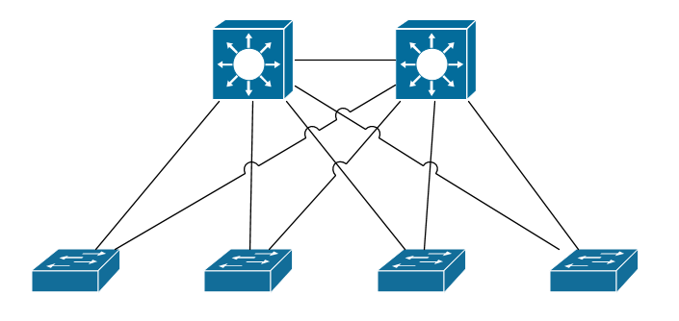
LAN Topologies – Collapsed Core
Core-Distribution
Much more typical of small-medium businesses
Usually what a small business aspires to become
Resilient and scalable
Access

Slide 8
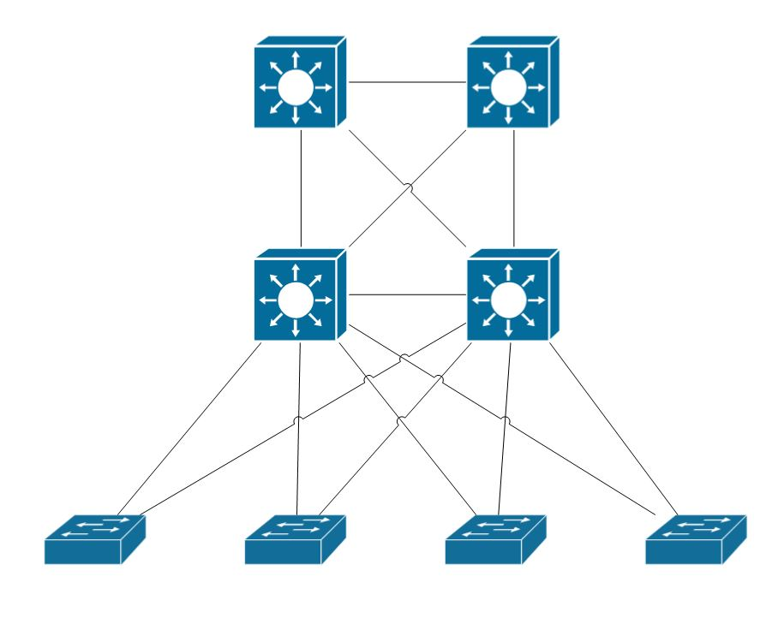
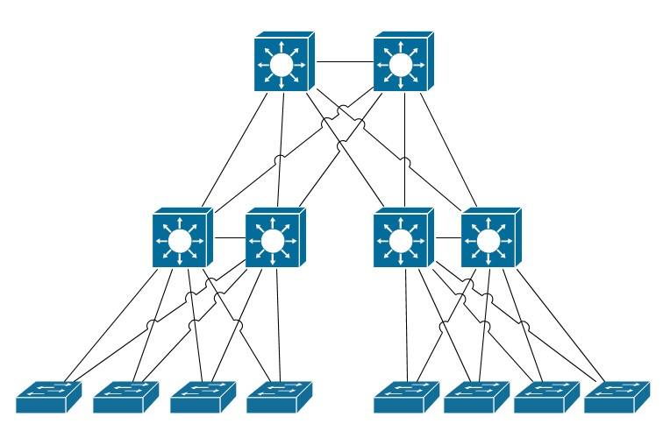
LAN Topologies – 3 Tier
The ultimate in scalability
Core
Distribution
Access

